Slide 1
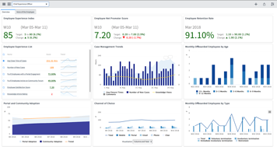
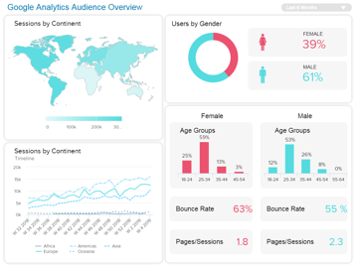
Analytics Dashboards
There are many tools on the market to help visualize data in graphs and dashboards.
An interactive dashboard is a combination of graphs, text fields, and controls
allowing user to select the data, filter data (for example, by date range or
by geography or by user), aggregate, compare. etc.
The data queries are usually formulated in SQL.
Most common dashboards are:
Microsoft Power BI - https://powerbi.microsoft.com/en-us/
Tableau - https://www.tableau.com/
Qlik - https://www.qlik.com/us/
Google DataStudio - https://datastudio.google.com/
Chartio - https://chartio.com/
Jupyter dashboards - https://voila.readthedocs.io/en/stable/
Apache Superset - https://superset.incubator.apache.org/ ( also https://preset.io/ )
KNIME (Konstanz Information Miner) - free open-source data analytics, reporting and integration platform - https://www.knime.com/
Here is a demo of how fast Microsoft Power BI Premium works with MS SQL Server - 500+ Mln rows of data - https://www.youtube.com/watch?v=mQyFp2MSl-s
And here is a demo of Kinetica DB using Tableau & Power BI:
- https://www.youtube.com/watch?v=7XliLU7ZC_s
Notice:
- sub-second response on billions of rows of data
- no need in waiting to create indexes, fast load (even live streaming) of data (modern databases use columnstore indexes - and are highly parallelized)
- https://docs.microsoft.com/en-us/sql/relational-databases/indexes/columnstore-indexes-overview?view=sql-server-2017

Slide 2
The top leaders for analytics platforms are Microsoft and Tableau.
Both use standard SQL to get data.
https://www.gartner.com/doc/reprints?id=1-65P04FG&ct=190125
Which database to use?
There are many options for SQL database.
For example, on Azure Cloud - Azure SQL Data Warehouse
- https://azure.microsoft.com/en-us/services/sql-data-warehouse/
BI & Power BI - https://powerbi.microsoft.com/en-us/
On Google Cloud we can use "Cloud SQL" (managed PostgreSQL) or BigQuery.
We can also consider GPU-based databases, for example:
- Kinetica on Google Cloud
- https://www.kinetica.com/partner/google-cloud-platform/
- MapD = OmniSci
- https://www.omnisci.com/
Similar options are available on AWS: Amazon RDS (PostgreSQL), Redshift, SnowFlake, Aurora, kinetica, MapD, etc.
Generally for sizes more than 1TB it is preferable to have a distributed DB like Google BigQuery (or Amazon SnowFlake.net)
https://statsbot.co/blog/modern-data-warehouse
Speed depends on the size of the data too.
At small sizes (<1TB) single-node solutions are faster (GPU-based are fastest).
So it maybe either one reasonably fast DB (Azure SQL Datawarehouse), or two databases - on big - but slow (Google BigQuery), and second smaller - but very fast (omnisci MapD GPU DB for interactive visual querying)
- https://fivetran.com/blog/warehouse-benchmark
- https://www.omnisci.com/demos/

Slide 3
Open Source for building dashboards
Apache Druid
columnar storage
Apache Airflow
workflow management
Apache Superset
Dashboards
Apache Superset, open-source, similar to Tableau or Chartio ( https://chartio.com/ ). The dashboard definition is in JSON file, the data is queried using SQL from a database.
- https://superset.incubator.apache.org/installation.html#getting-started - https://www.youtube.com/watch?v=AqousXQ7YHw – 15 min demo - https://youtu.be/24XDOkGJrEY - very good lecture (history and anatomy of Apache Superset).
Looks like it has good documentation on how to install it on Linux, Mac, or Windows. And how to work with various SQL databases. Superset's stack is: Python backend (Flask App Builder (authentication, roles, CRUD,...), pandas, SqlAlchemy) + Javascript frontend Here are some examples from nvd3.org - http://nvd3.org/examples/index.html
Try clicking on charts - enjoy animation effects - http://nvd3.org/examples/stackedArea.html
Superset works very well with Druid - https://druid.apache.org/ -
Watch this lecture - https://www.youtube.com/watch?v=vbH8E0nH2Nw - lecture about technologies to be used behind Interactive dashboards. He goes over OLAP, SQL, star-schema, key-value stores, and columnar stores. Then describes in detail why Druid is an excellent solution.
Jupyter Dashboards:
Jupyter notebooks and dashboards - https://annefou.github.io/jupyter_dashboards/02-dashboards/index.html
Jupyter Lab - https://jupyterlab.readthedocs.io/en/stable/
Jupyter Dashboards - https://github.com/jupyter/dashboards
Voila - serve dashboards - https://github.com/voila-dashboards/voila - now part of jupyter
================================
ipywidgets - https://github.com/jupyter-widgets/ipywidgets - https://www.youtube.com/watch?v=i40d8-Hu4vM (40 min demo from 2017)
bqplot - https://github.com/bloomberg/bqplot - https://www.youtube.com/watch?v=Dmxa2Kyfzxk (demo 2018)
Bokeh - interactive graphics - https://docs.bokeh.org/en/latest/docs/user_guide.html
ipyvolume - 3-D visualization (rotate & resize 3D graphs) in Jupyter - https://github.com/maartenbreddels/ipyvolume
Apache Druid - http://druid.io - open-source analytics data store (OLAP). Fast data ingestion and aggregation, scales to trillions of events and petabytes of data. Druid is best used to power analytic dashboards and applications.
Apache Calcite - https://calcite.apache.org/ - translate SQL to JSON queries for Druid and other systems
Visualization - why so many packages? - https://www.anaconda.com/python-data-visualization-2018-why-so-many-libraries/
Visualization for R - Shiny (R-Studio) - https://shiny.rstudio.com/

Slide 4
Jupyter Dashboards – open source and flexibility
A Gallery of Voilà Examples
https://blog.jupyter.org/a-gallery-of-voil%C3%A0-examples-a2ce7ef99130
Voila, widgets, extrapolations
https://jupyter-flex.extrapolations.dev/voila-ipywidgets/ -
Configure your dashboards with Voilà gridstack template
https://blog.jupyter.org/voila-gridstack-template-8a431c2b353e -

Slide 5

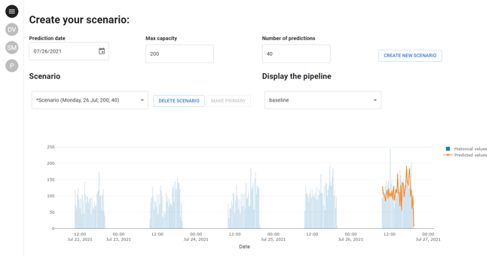
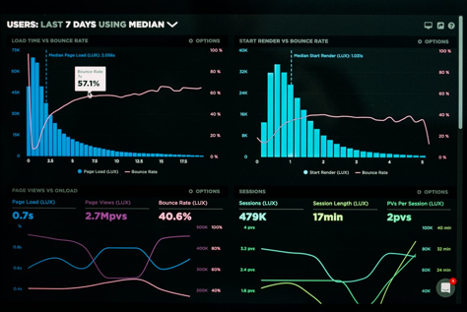
Taipy
open-source Python web-application builder
turns Data and AI algorithms into full web apps in no time
https://www.taipy.io
https://docs.taipy.io/en/latest/
https://github.com/Avaiga/taipy
https://betterprogramming.pub/discovering-taipy-and-taipy-gui-e1b664765017
https://www.youtube.com/watch?v=rOsytU9ERAQ
pip install taipy
from taipy import Gui
page = """ some text """
Gui(page).run(use_reloader=True)

Slide 6
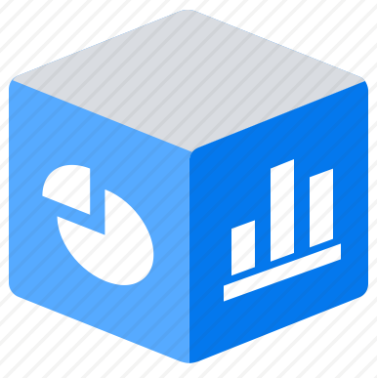
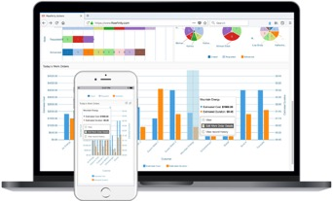


Typical Data Organization for Analytics
OLTP
DB
Queries
Files
Results
OLAP database with columnar storage for fast and flexible querying (a.k.a. Analytical Store).
Interactive
Dashboards
(Power BI, Tableau, etc.)
Rise and Fall of the OLAP Cubes:
https://www.holistics.io/blog/the-rise-and-fall-of-the-olap-cube/

Slide 7
Databases optimized for analytics.
Databases can be optimized for OLTP (On-Line Transactional Processing) or OLAP (On-Line Analytical Processing). For analytics we need OLAP databases.
They achieve high performance of queries by using columnar indexes, massive parallelism, taking advantage of large memory and GPU.
Columnar Indexes:
Here is a short video (4 min) made long time ago (in 2011) showing performance advantage of columnar store indexes in Microsoft SQL server.
- https://www.youtube.com/watch?v=vPN8_PCsJm4
The video demonstrates that columnar indexing is at least 40 times faster than traditional index. The query was done over a 2 Billion rows "fact" table.
Note - this video is ~8 years old. Since then MS SQL Server made lots of other performance improvements.
Note: first release of MS SQL Server was on April 24, 1989, 30 years!!
Modern hardware is much faster than that used in the above video.
Columnar store indexing is standard/default nowadays.
And of course it is available on Microsoft SQL Server on Azure cloud.
Microsoft SQL Datawarehouse on Azure cloud - fast OLAP solution.
- https://azure.microsoft.com/en-us/services/sql-data-warehouse/
SSAS = Microsoft SQL Server Analysis Services – uses tabular models
( in-memory compressed databases) for serving fast queries to BI tools:
- https://en.wikipedia.org/wiki/Microsoft_Analysis_Services
Power BI - Standard Microsoft Business Intelligence tool
- https://powerbi.microsoft.com
Demo of how fast Power BI Premium works with MS SQL Server - 500+ Mln rows of data
- https://www.youtube.com/watch?v=mQyFp2MSl-s
Demo of Kinetica DB using Tableau & Power BI:
- https://www.youtube.com/watch?v=7XliLU7ZC_s
Notice:
- sub-second response on billions of rows of data
- not need to create indexes, no wait time, fast load (even live streaming) of data
Main points:
- you can select from many different BI tools - they all support SQL
- you can select from many SQL databases - they are fast
- you can simplify your development time using standard SQL features
- you can select dedicated hardware to tune your speed
- you can achieve very fast response time
- you can enjoy lower prices

Slide 8
Columnar Index = Columnstore Indexes
A column-oriented DBMS (or columnar database management system) stores data tables by column rather than by row. Mostly used for analytical queries on large tables. Query performance can be 10-40 times faster than in traditional row-accessing DBMS.
But inserts are slower (need to add and compress) - not suited for OLTP transactional databases.
Column data is of uniform type – therefore it can be compressed better than row-oriented data (using bitmap indexes and sorting).
Traditional Row-storing DB | Columnar storing DB
Excessive disk IO – read whole rows, discards most columns | Disk IO smaller because we need to read only few columns. This allows to fit more rows into memory, thus making the query much faster (all-in-memory).
Compression is not very good. | Good data compression using the fact that all data in one column has the same type.
Good random access. | Good for analytics, not so good for random access.
Can use clustered and nonclustered indexes. | Columnstore index is usually clustered. But also can use separate nonclustered indexes for some columns.
Good for transactions (OLTP) | Good for read-only analytical queries in big fact tables (OLAP)

Slide 9
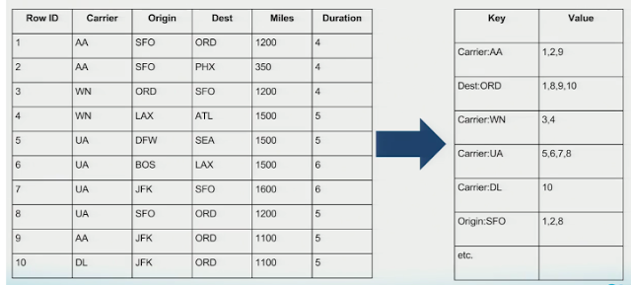
Inverted Indexes:
Salesforce Einstein Analytics stores data not in regular SQL database, but in files and so called "inverted indexes" (II).
The motivation for selecting this technology was to have fast interactive data access.
The price to pay - the slowness of creating these "inverted indexes".
Every time you add data - you need to rebuild the whole index.
This article gives a nice explanation of what is II:
- https://www.eternussolutions.com/2016/11/13/10-things-love-wave-analytics/
And here is a picture showing the data - and its inverted index.
I've first worked with an SQL database with compressed bitmap indexes in 2001-2002. The database was called "Sybase IQ".
It was an SQL database for doing analytics (as opposed to transactional processing).
Since then most SQL database vendors have adopted this "columnar indexing". They switched from row-oriented storage and indexing to compressed column-oriented storage.
This is basically equivalent to the "Inverted Index" idea.
Modern SQL databases can provide performance much faster than EA. You just need to select an implementation with appropriate characteristics.
For example, on AWS (or other clouds) you can select a GPU-based SQL database on a server with terabytes of memory.
This database can query the data and give updates with a speed of a live movie (milliseconds) !!
And we can still use conventional ETL tools and enjoy fast data load speeds.
Inverted indexes are usually implemented as compressed bitmaps - and cached in memory.
They may be also implemented as "conventional" trees.
Here are more links about Inverted indexes:
- https://www.quora.com/In-database-design-what-exactly-is-the-difference-between-inverted-index-and-a-normal-index
- https://stackoverflow.com/questions/47537318/b-tree-index-vs-inverted-index
- https://en.wikipedia.org/wiki/Inverted_index

Slide 10



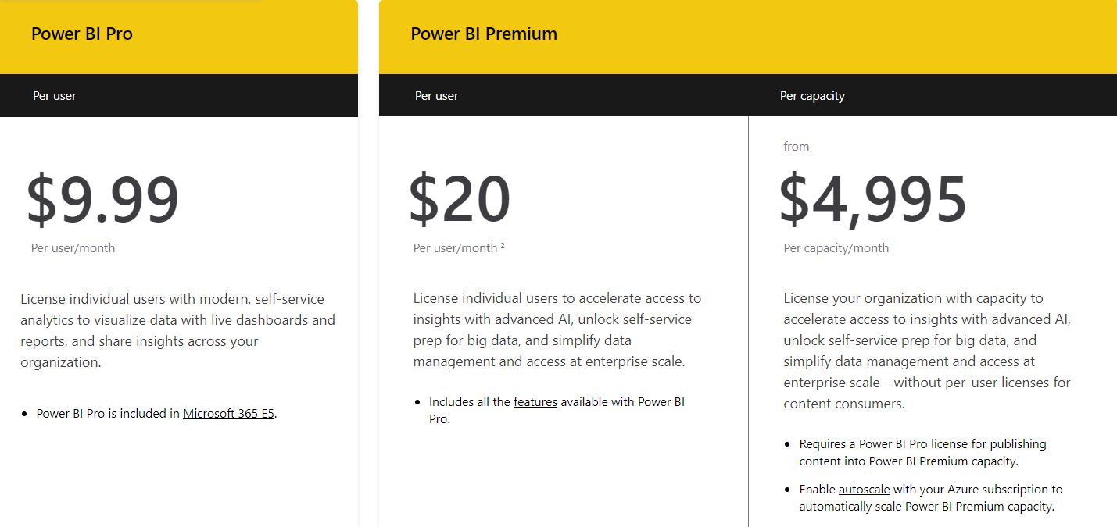
Power BI
First released in July 24, 2015
History
SSAS (Microsoft SQL Server Analysis Services).
1999 - MOLAP - multidimensional engine and MDX (pre-aggregated data)
2009 - tabular VertiPaq engine and DAX (vertically packed in-memory data)
2015 – first release of Power BI
MDX (MultiDimensional eXpressions) – by Mosha Pasumansky
https://en.wikipedia.org/wiki/Mosha_Pasumansky
https://www.linkedin.com/in/mosha/
https://www.youtube.com/watch?v=mX51gMNsT5M (Mosha sings)
DAX (Data Analysis eXpressions) by Amir Netz , Cristian Petculescu, and Microsoft team,
self-service, measure-based, visual, interactive, slice/dice.
https://en.wikipedia.org/wiki/Data_analysis_expressions
https://www.kasperonbi.com/the-rise-and-history-of-power-bi-with-amir-netz/
https://www.youtube.com/watch?v=izOppfQGanI
https://news.microsoft.com/stories/people/amir-netz.html
Amir Netz Microsoft since 1997
Cristian Petculescu Microsoft since 1997
Pro vs Premium
https://docs.microsoft.com/en-us/power-bi/transform-model/desktop-ai-insights
https://docs.microsoft.com/en-us/power-bi/connect-data/service-aml-integrate
https://docs.microsoft.com/en-us/azure/azure-sql-edge/deploy-onnx
https://stackoverflow.com/questions/65899552/consuming-an-deployed-azure-ml-model-in-powerbi
https://docs.microsoft.com/en-us/azure/machine-learning/tutorial-power-bi-custom-model
https://docs.microsoft.com/en-us/power-bi/connect-data/service-aml-integrate?context=azure/machine-learning/context/ml-context
https://www.encorebusiness.com/blog/power-bi-premium-p1-vs-p2-vs-p3/
https://docs.microsoft.com/en-us/azure/machine-learning/concept-endpoints

